Slide 1
IoT Smart Watering System
Course Details
Embedded Systems and IoT
CSE232
Presenters
S.M. Ashibur Rahman 221-15-5137
Tanvir Rahman Shuvro 221-15-5648
Course Tutor
Md. Taslim Arif
Lecturer
Department of CSE
Daffodil International University

Slide 2
Contribution Table
S.M. Ashibur Rahman 221-15-5137 | Hardware and Software
Tanvir Rahman Shuvro 221-15-5648 | Hardware and Report

Slide 3
Problem Statement
Traditional irrigation methods often lead to overwatering or underwatering, wasting water and affecting plant health. Farmers and gardeners need to manually check soil conditions, which is time-consuming and inefficient. There is a lack of low-cost, user-friendly systems that can both automate watering and allow remote monitoring/control.

Slide 4
Introduction
Our project, Smart Watering System using IoT, is designed to automate and remotely monitor the irrigation process. It uses an ESP32 microcontroller, DHT11 sensor for temperature and humidity, YL-69 soil moisture sensor, and a relay-controlled water pump. Data is displayed in real-time through the Blynk IoT platform and a local web server, enabling both automatic and manual control. This system aims to make gardening and farming more efficient, reducing human effort and saving water.

Slide 5
Gap Analysis
Paper Name | Author(s) | Year | Approach/Method | Limitations | Research Gap
IoT Based Smart Irrigation System | Patel et al. | 2020 | Used Arduino Uno with soil sensor and GSM module | Only SMS-based control, no real-time dashboard | Lack of cloud/web-based monitoring
Automated Irrigation Using Soil Moisture Sensor | Singh & Verma | 2019 | Simple relay + YL-69 moisture sensor | No temperature/humidity consideration | Does not provide holistic environment data
Smart Agriculture Using IoT | Reddy et al. | 2021 | ESP8266 with mobile app control | Limited scalability, no local server option | Weak offline/local control support
Water-Saving Irrigation System | Khan et al. | 2022 | Used threshold-based irrigation with NodeMCU | No manual override for pump | Lack of dual control (manual + automatic)
IoT-Enabled Crop Monitoring | Sharma & Das | 2023 | Blynk-based data visualization with sensors | No feedback mechanism of pump status | Does not synchronize actual device state with app

Slide 6
Our Contribution
Combines automatic + manual pump control.
Provides real-time monitoring via Blynk IoT + Local Web Server.
Syncs pump status with app/dashboard for transparency.
Low-cost, scalable solution suitable for smart gardening and small-scale agriculture.

Slide 7
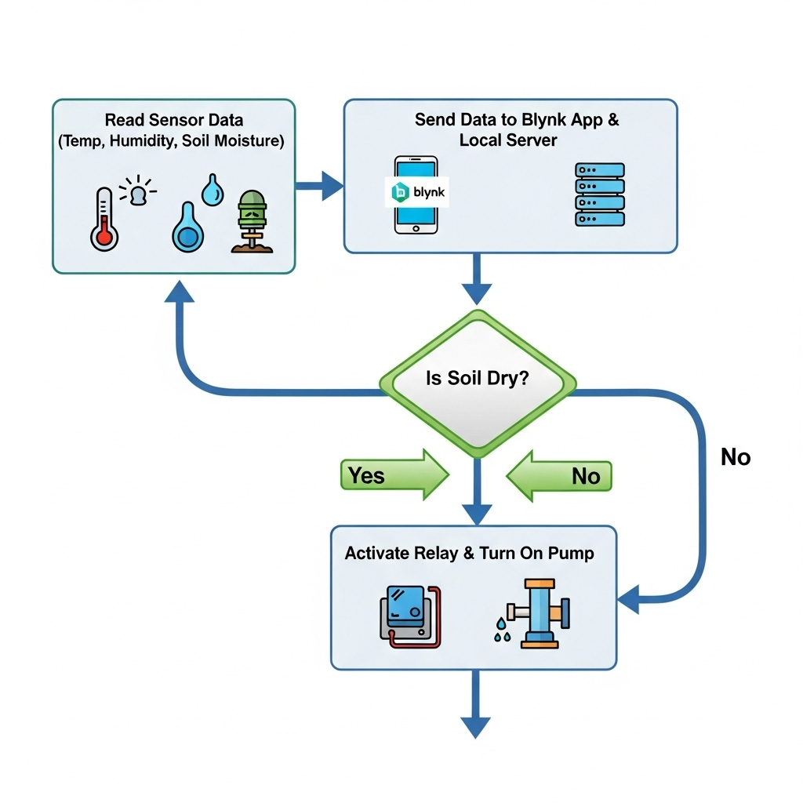
System Architecture
This flow diagram shows an IoT system that continuously monitors a plant's environment by reading sensor data and sending it to a mobile app and server. Based on the soil moisture level, the system automatically activates a water pump whenever the soil becomes too dry.

Slide 8
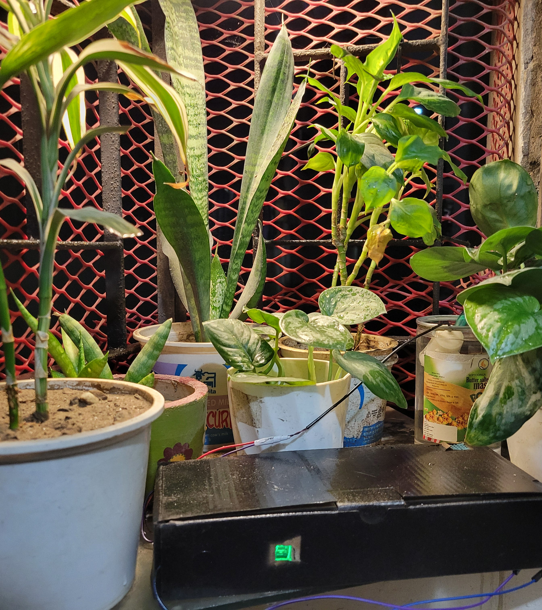
Ptototype
We will customize this box with a more compact in size.

Slide 9
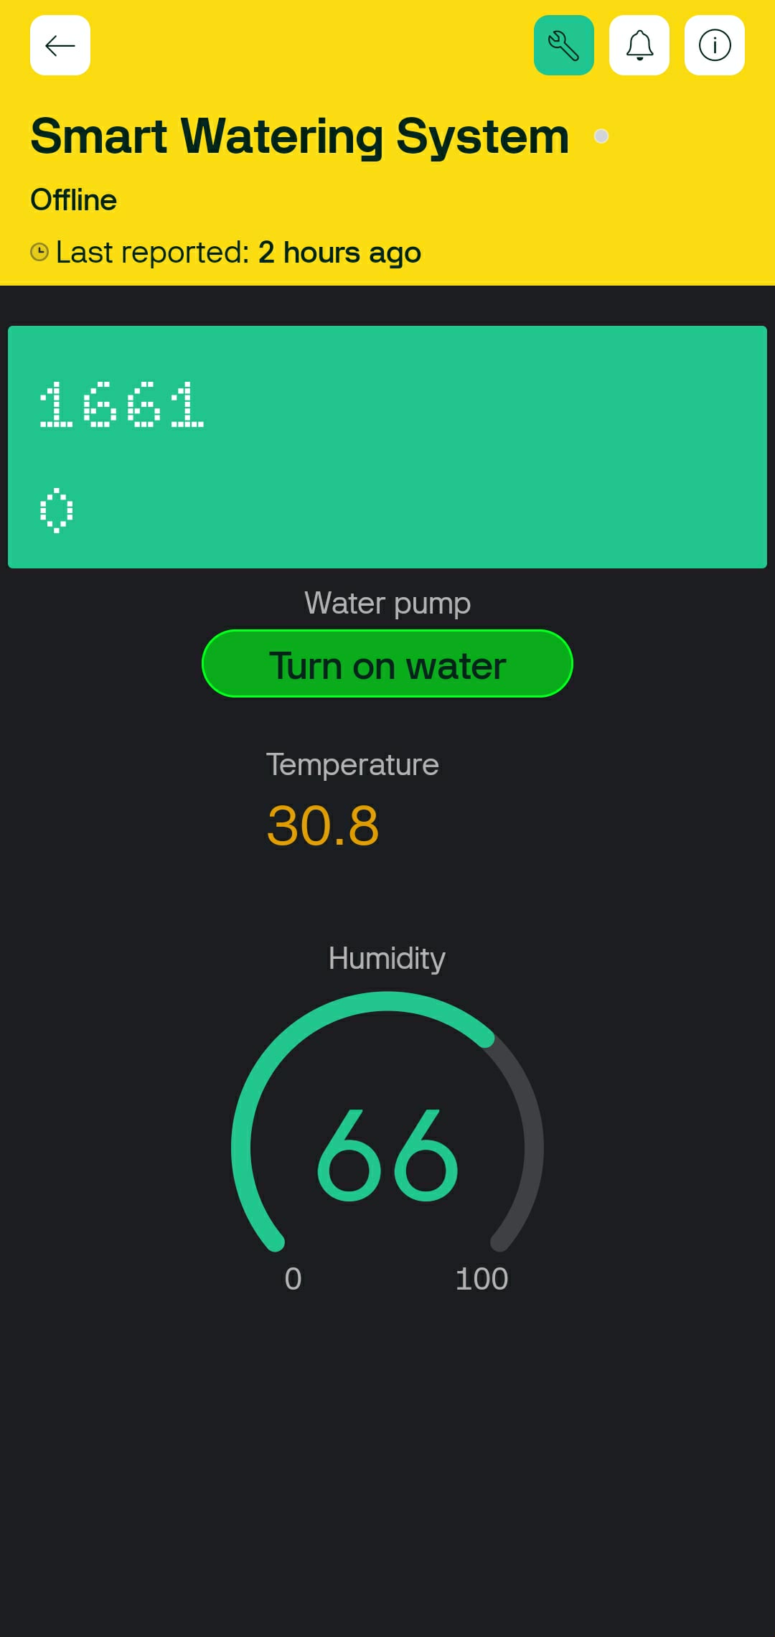
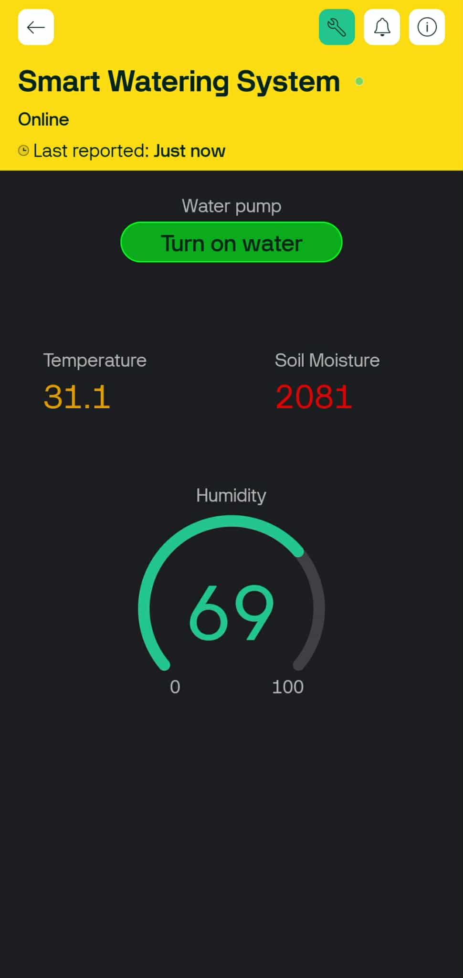
App Interfaces
When Offline
When Online

Slide 10
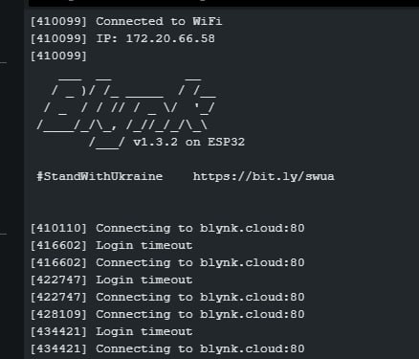
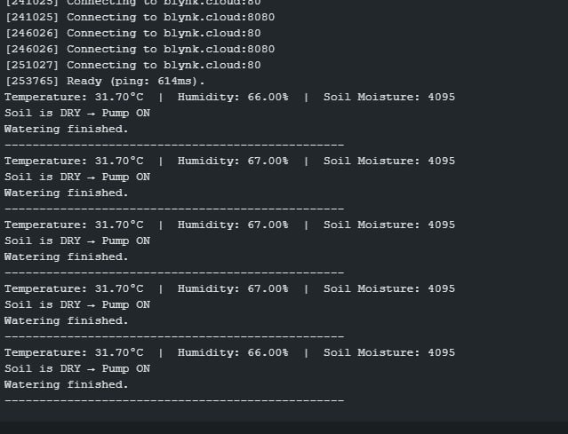
Output on Serial Monitor

Slide 11
Conclusions
Developed a low-cost IoT-based smart watering system.
Enables automatic irrigation based on soil moisture.
Provides real-time monitoring and manual control via Blynk and local server.
Helps in reducing water wastage and ensuring healthy plant growth.
A step towards smart agriculture and sustainable resource use.

Slide 12
References
Ghilmi, A., Minarto, E., & Tamyiz, M. (2023). Smart gardening automation using IoT with Blynk App. Retrieved from ResearchGate
Badhan, A., Sahni, D., Maddheshiya, A., Roy, D., & Singh, A. (2024). Smart farming utilizing Blynk server: Wireless control for irrigation water lanes and security. Retrieved from ResearchGate
Kunt, R. (2025). Development of a smart autonomous irrigation system using IoT and AI. arXiv preprint. https://arxiv.org/abs/2506.11835
Sattar, S., Arslan, M., Majeed, A., & Iqbal, N. (2025). Wireless sensor networks data synchronization in precision agriculture. arXiv preprint. https://arxiv.org/abs/2502.18671
Simulation and construction of a solar-powered smart irrigation system using Internet of Things (IoT) & Blynk mobile app. (2025). ResearchGate. https://www.researchgate.net/publication/364337201

Slide 13
“
Any Question?

Slide 14
Thank you.

